Slide 1
Real estate agent
price predicting
In Bangkok, Nonthaburi and Samut Prakan
Notes:
good afternoon everyone today Im gonna present you guys some interesting exploration information in order for Real estate agent in the topic of .....

Slide 2
01
Background & Problem statement
Agenda
02
Methodology
03
Data Cleaning and EDA
04
Modelling & Evaluation
05
Conclusion & Recommendation & Limitation

Slide 3
Background
Even though the economic situation has not yet recovered as expected from the COVID situation. But consumer demand for housing still exists, whether buying or renting. As many business sectors have returned to normal operations, many people have started looking for a place to live close to their workplace. Bangkok is still the most popular province that receives interest in purchasing real estate, followed by metropolitan areas and tourist provinces.

Slide 4
Problem statement
As a real estate agent, How can we know the buying/selling prices in the market to set prices competitive with competitors in Bangkok and metropolitan areas to make more profit for company?

Slide 5
Methodology
Limitation
Feature Engineering
Data Cleaning
Modeling and Prediction
Conclusion and
Recommendation
.
EDA
Start
Data Collection

Slide 6
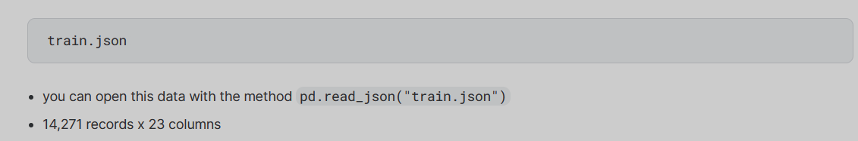
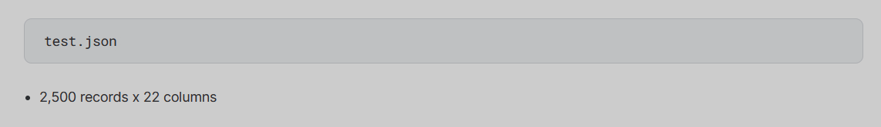
Data collection
Data collection
Notes:
We downloaded the 2 data files from Kaggle website which are
train.json - the training set WITH target value price
test.json - the test set WITHOUT target value price
Then Import 2 files as DFs to JP to do data processing afterwards

Slide 7
Data Cleansing

Slide 8
Data cleansing
Data Cleansing
Notes:
Next, it is showing the columns has been handled with data cleansing process such as
Removing null value with Subdistrict
Checking outlier of price but not found
Filtering out unnecessary 8 columns
And Filling out Null value to be 0 for 3 columns

Slide 9
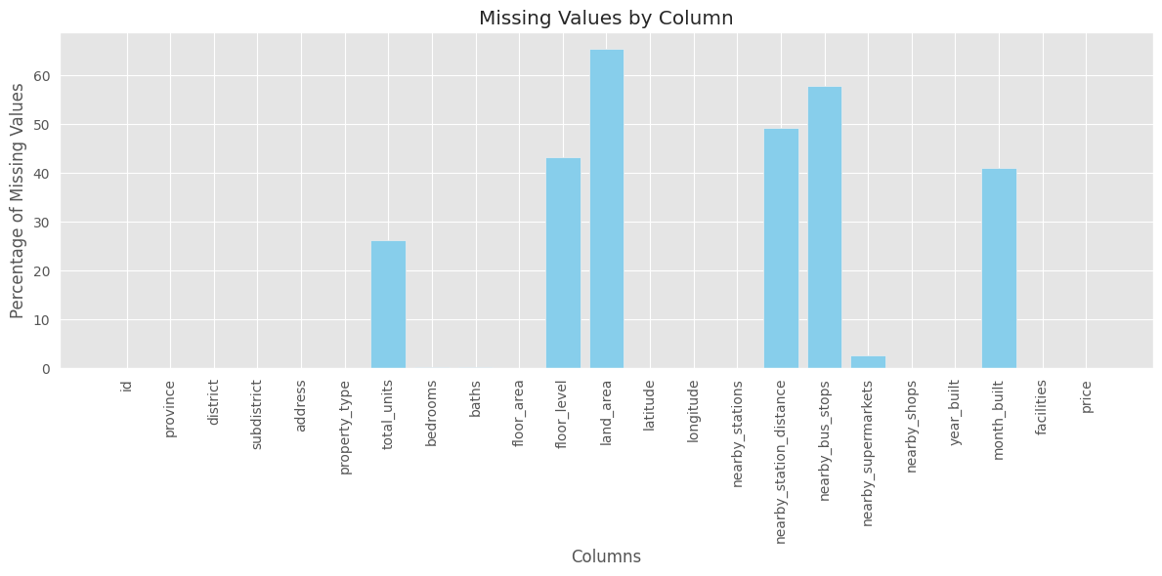
Exploratory Data Analysis : Missing values
EDA
Notes:
In the part of EDA we suspected a numbers of columns coataining a huge missing values
Which we display a bar chart for percentage of missing values in each columns so you could see that there are 7 columns with visibe blue bars

Slide 10
Feature Selection
EDA
Notes:
So we decided to use the rest of useful columns which have less missing values in other 14 columns
And it has been considered that they are important factors that affect the customer's choice of buying real estate.
as you can see in the red box.

Slide 11
Feature Engineering
EDA
Notes:
Then we do the feature engineering process for example
Dummifying for provice, propoty type, district and subdistrict columns
And imputing missing data with KNN technique for year built column

Slide 12
Modeling
Notes:
The first place of all model types is Linear regression come with the best score R2 is 0.65873177 and RMSE is 1271513.199
The second place is Lasso model with R2 is 0.658730374 and RMSE is 1271515.799

Slide 13
Modeling
Model comparison with Hyper parameters (Tune Hyperparameters with GridSearchCV)
Notes:
The first place is taken by 2 model type which are Elastic net and Lasso with the same score as R2 is 0.658604451 and RMSE is 1271750
Wit

Slide 14
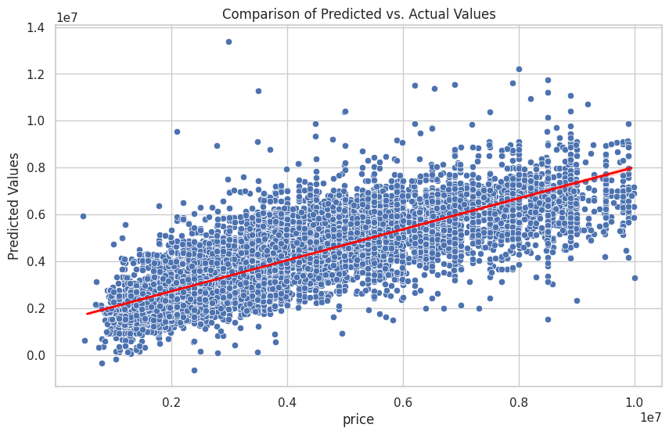
+
Modeling
Selection Model : ElasticNet
hyperparameters :
{'alpha': 2.0, 'l1_ratio': 1.0, 'max_iter': 100}
R2 = 0.658604451057883
RMSE = 1271750
(mil baht)
Notes:
We finally choose ElasticNet model to fit data with because I think it has more hyper parameters to tune than other types
So I assumed that it could have most accuracy if the data cleaning process has dealt with data completely at the first stage
From the grapgh showing that
At the beginning of the price from 0 to 0.8 million baht. The model can make predictions that are quite close to the accuracy value.
Because we can see the prediction line is close to the accuracy value with a highly intensity distribution. Meanwhile,
values after 0.8 million baht onwards The prediction line is quite far from the accuracy value significantly.

Slide 15
Conclusion
The type of property likely has a significant impact on the price.
Detached houses have higher prices compared to condos and townhouses.
District, province, subdistrict, latitude and longitude can significantly affect the price.
Properties in specific districts or provinces may be more expensive due to their desirability.
The presence of nearby amenities such as supermarkets, and nearby stations (MRT, BTS) can impact prices.
Properties located closer to public transportation (BTS, MRT) may command higher prices.
Properties with more bedrooms and bathrooms, larger floor areas, and newer constructions may have higher prices.

Slide 16
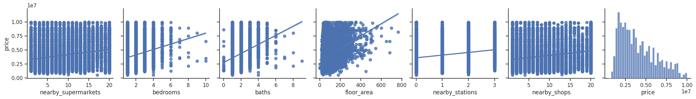

Slide 17
Recommendation
Identify the most popular property types in the area and focus on marketing and sales efforts for those types.
Analyze which districts, provinces, and subdistricts have the highest demand. Focus on opportunities to make more profits from those areas.
For some customers who have a limited budget to purchase real estate. We can use data on real estate prices in each area to make recommendations so we could rapidly specific area to match with limited budget.

Slide 18
Example of most popular property type in each district ordering by alphabet ascending
Top 10 highest mean prices of district

Slide 19
Limitation
During the data cleaning, If there is a separation of property type column between condos and detached houses + townhouses as there is unequal data containing between them in floor level and floor area.
Then, use KNN technique to fill in the missing data in each column to make the model prediction more accurate.

Slide 20

THANK YOU

